Slide 1
DESIGN THINKING FOR INNOVATION & ENTREPRENEURSHIP (DTIE) | SECTION: PROJECT BATCH-A
EduPulse: Student Curriculum & Attendance System
Unified academic tracking platform for real-time attendance analytics and structured curriculum progression.
Live Web App: https://edupulse-one-fawn.vercel.app/

Slide 2
DTIE | DEPARTMENT OF MULTI DISCIPLINARY INNOVATION & ENTREPRENEURSHIP
Team Members
Mokshit
Vikas
Vinay
ID: 2620030124
ID: 2620030391
ID: 2620030387
Jayanth
Navaneeth
Charan
ID: 2620090100
ID: 2620030694
ID: 2620080093

Slide 3


DTIE | STRATEGIC DIRECTION
Vision and Mission
Our Vision
Our Mission
Create paperless campuses powered by transparent real-time academic intelligence.
Unify daily attendance logs alongside syllabus milestones inside one accessible web portal.

Slide 4



DTIE | CORE CHALLENGE
Problem Statement
Manual Roll Calls
Disconnected Syllabus
Late Shortage Alerts
Paper registers waste 10 minutes per lecture.
Curriculum progress lives in isolated spreadsheets.
Students discover attendance deficits right before exams.

Slide 5
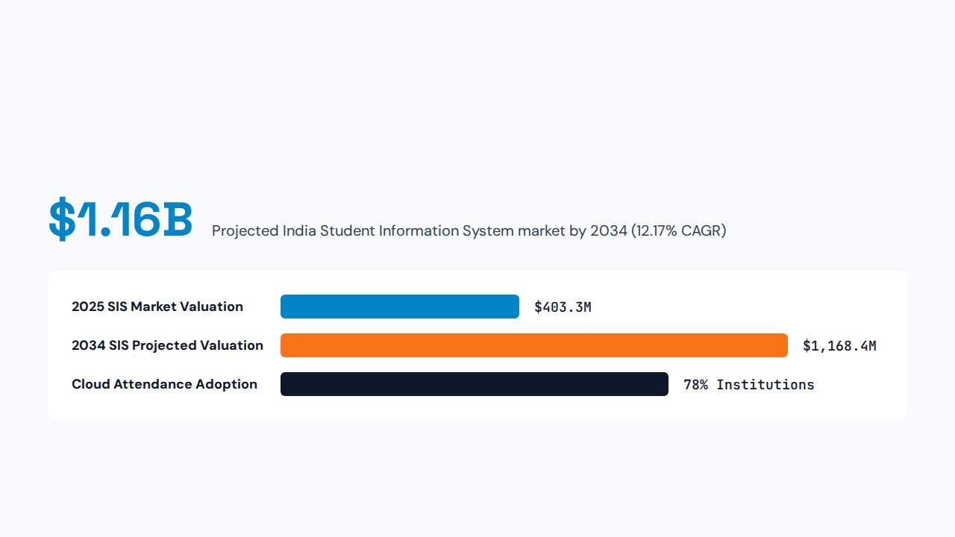
DTIE | INDUSTRY VALIDATION
Research & Market Study

Slide 6

DTIE | STAKEHOLDER ECOSYSTEM
Target User & Customer Segments
University & College Students
Track live attendance percentages alongside daily topic schedules.
Faculty & Course Instructors
Log class attendance rapidly inside unified course modules.
Department Administrators
Monitor cohort compliance metrics across academic departments.

Slide 7
DTIE | COMPETITIVE LANDSCAPE
Competitors & Benchmarks
Feature / Benchmark | Manual Registers | Legacy Campus ERP | Generic LMS | EduPulse Web App
Real-Time Attendance | Delayed manual tally | Slow batch sync | Plugin dependent | Instant cloud sync
Curriculum Mapping | Paper syllabus files | Static PDF uploads | Course files only | Interactive module tracker
Deployment Speed | Immediate setup | 6-month onboarding | Weeks of configuration | Zero-install Vercel web app
User Experience | Zero student visibility | Cluttered interface | Fragmented navigation | Clean role-based dashboard

Slide 8
DTIE | VULNERABILITIES & OPPORTUNITY
Market Gaps & Risk Mitigation
Existing Market Gaps
Operational Risks & Defenses
Siloed Portals: Attendance tools ignore syllabus pacing.
Proxy Attendance: Solved via time-bound session verification.
High ERP Costs: Small colleges cannot afford heavy licenses.
Faculty Resistance: Solved via single-click roster marking.
Opaque Metrics: Students lack predictive shortage warnings.
Data Privacy: Solved via role-based access authentication.

Slide 9

DTIE | LIVE PRODUCT PROTOTYPE
Product Solution: EduPulse Web App
https://edupulse-one-fawn.vercel.app/
Smart Attendance Ledger: Instant subject-wise presence logging.
Curriculum Milestone Tracker: Unit-by-unit syllabus completion progress.
75% Eligibility Radar: Automated visual alerts for shortage risk.
Cloud Deployment: Responsive Vercel web app across devices.

Slide 10
DTIE | SYSTEM WORKFLOW
System Architecture & User Storyboard
1. Role Login
2. Lecture Sync
3. Cloud Engine
4. Live Analytics
Secure portal access for students or faculty.
Faculty marks attendance alongside topic covered.
Vercel frontend updates real-time state records.
Student views updated attendance and syllabus bar.

Slide 11
DTIE | BUSINESS MODEL ARCHITECTURE
Lean Canvas Model
Problem
Solution
Unique Value
Unfair Advantage
Manual attendance errors
Unified curriculum web portal
Zero-friction syllabus plus attendance
Instant serverless cloud onboarding
Key Metrics
Channels
Cost Structure
Revenue Streams
Daily active campus logins
Direct college pilot programs
Cloud hosting plus database tiers
Annual B2B SaaS per-student fee

Slide 12
DTIE | FINANCIAL PROJECTIONS
Capital & Financial Plan
₹1.5 Lakhs
₹150 / yr
8 Months
Initial Seed Requirement (Year 1)
SaaS Subscription Per Student
Projected Break-Even Horizon
Cloud & DB Infrastructure: 40% Allocation
Product R&D & Security: 35% Allocation
Campus Onboarding: 25% Allocation

Slide 13
DTIE | EXECUTION MILESTONES
Product Roadmap & Timeline
Q1 • COMPLETED
Q2 • PILOT PHASE
Q3 • AI UPGRADE
Q4 • SCALE
Web MVP Launch
Batch-A Testing
Smart Alerts
Multi-Campus SaaS
Live prototype deployed on Vercel.
Cohort onboarding with live feedback.
Automated parent SMS shortage alerts.
Institutional licensing across universities.

Slide 14
EDUPULSE WEB APP | INTEGRATED CURRICULUM ENGINE
Live Curriculum & Study Modules
MFC • 4 CREDITS
PJ • 4 CREDITS
DDCA • 4 CREDITS
LSE • 2 CREDITS
Mathematics for Computation
Programming in Java
Digital Design & Architecture
Language Skills for Engineering
Sets, matrices, combinatorics, Bayes probability.
JVM foundations, OOP, polymorphism, collections.
K-maps, flip-flops, CPU datapath hierarchy.
Technical reports, presentations, interview etiquette.

Slide 15
EDUPULSE WEB APP | DUAL-ROLE INTERFACE
Student & Teacher Portal Features
Student Portal (Aarav, Diya + 8)
Teacher Portal (Prof. Anita Rao)
30-Session Heatmap: Visual grid of Present, Late, Absent history.
Rapid Keyboard Marking: Press P, A, or L with arrow navigation.
Skip & Recovery Calculator: Exact classes needed to reach 75%.
At-Risk Cohort Radar: Instant filter for students below 75%.
Topic Checklists & Notes: Unit-wise study notes with progress rings.
Live Syllabus Sync: One-click "Taught" badge updates student views.

Slide 16
EDUPULSE WEB APP | ALGORITHMIC TRANSPARENCY
Attendance Calculation & Risk Thresholds
Safe Status (≥ 75%)
Displays exact number of safe classes a student can miss.
Weighted Session Formula
At Risk Status (65% – 74%)
Half-attendance credit for late arrivals prevents unfair zero-credit penalties.
Triggers consecutive class recovery counter.
Critical Status (< 65%)
Flags student on Prof. Anita Rao's faculty dashboard.

Slide 17
DTIE END SEMESTER PITCH DECK | PROJECT BATCH-A
Thank You & Live Demo
Explore the live EduPulse Student Curriculum & Attendance System prototype:
https://edupulse-one-fawn.vercel.app/

Slide 18


Image Sources
https://img.magnific.com/premium-photo/black-university-student-using-laptop-class-modern-university-lecture-hall-college_324489-8705.jpg?w=360
Source: www.magnific.com
https://irp.cdn-website.com/26daf2b1/dms3rep/multi/opt/e947225c-74c4-4bc9-8c89-4b6469b12c02-640w.png
Source: www.ezpages.pro

